Slide 1
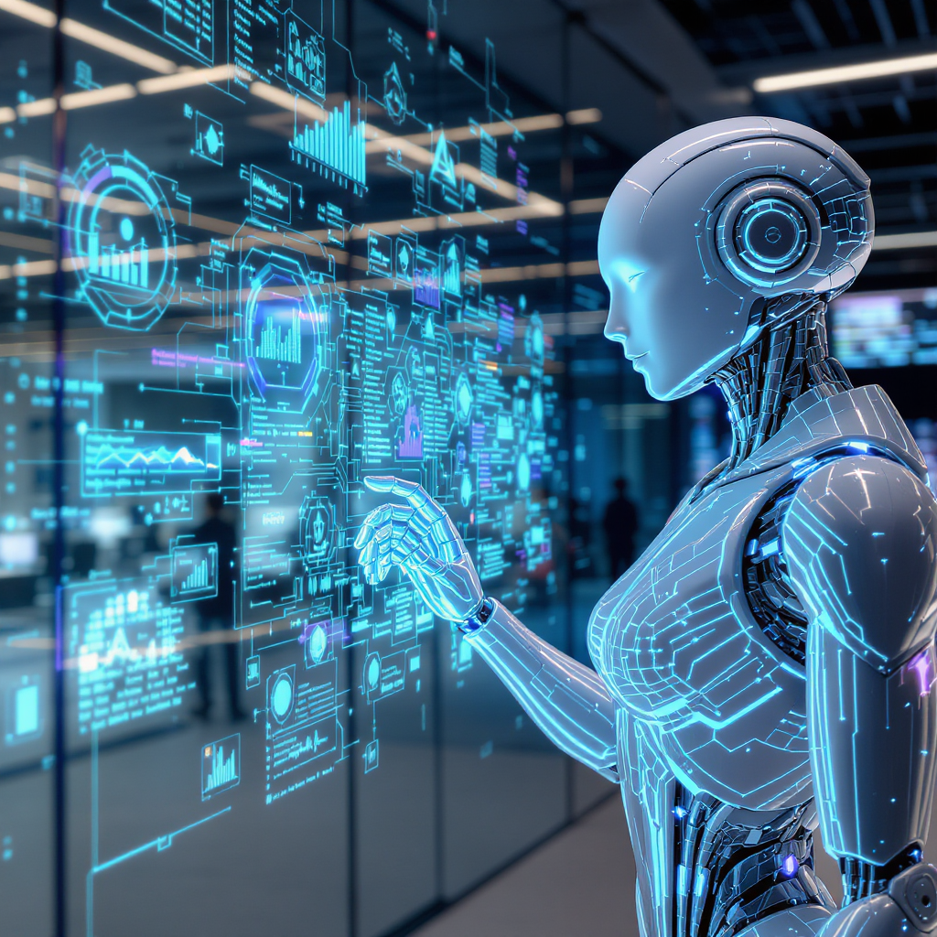
Agentic AI
THE FUTURE IS AUTONOMOUS
AI That Doesn't Wait for Instructions.
What happens when AI starts thinking for itself?
Autonomy · Reasoning · Action · Scale
April 7, 2026

Slide 2
Agenda
01
Defining Agentic AI
What it is and the five characteristics that set it apart
What We'll Cover
02
A New Paradigm
How agentic AI compares to traditional AI systems
03
Real-World Applications
Industries being transformed by autonomous agents
04
Under the Hood
The perception–reasoning–action loop and market momentum
05
Risks, Rewards & The Road Ahead
Opportunities, challenges, and the trends shaping what comes next

Slide 3
What Is Agentic AI?
Definition
Reactive and prompt-driven; responds only to direct commands.
Operates in single-turn interactions without ongoing context.
Executes narrow, specific tasks with limited scope.
Lacks persistent memory; forgets past interactions immediately.
Workflows are orchestrated and supervised by humans.
Notes:
Agentic AI refers to a class of artificial intelligence systems designed to exhibit autonomous, goal-directed behavior. These systems perceive their environment, make complex decisions, and take actions with minimal human intervention. Core concepts include agency — the ability to act independently; autonomy — operating without explicit step-by-step guidance; and goal-pursuit — continuously working toward objectives. Unlike traditional passive AI models that merely respond to user prompts or perform isolated tasks, agentic AI proactively plans, adapts, and executes multi-step processes to fulfill complex goals.

Slide 4
Five Defining Characteristics
Characteristics
Autonomy
Agentic AI operates independently without requiring step-by-step human instructions, enabling it to pursue goals on its own.
Reasoning
It breaks down complex problems into manageable parts and develops multi-step plans to achieve objectives effectively.
Tool Use
The AI can interact with external systems like APIs, databases, and software tools to gather information and execute tasks.
Planning
Agentic AI sets sub-goals and sequences actions strategically to ensure efficient progress toward its main objectives.
Memory
It retains context and information across interactions, allowing it to learn from past actions and improve future decisions.

Slide 5
Comparison
Agentic AI vs. Traditional AI: A New Paradigm
Traditional AI | AI Agent
Reactive and prompt-driven; responds only to direct commands | Proactive and goal-driven; plans and acts autonomously.
Operates in single-turn interactions without ongoing context. | Performs multi-step, long-term tasks with context retention.
Executes narrow, specific tasks with limited scope. | Utilizes broad cross-tool capabilities and integrations.
Lacks persistent memory; forgets past interactions immediately. | Maintains persistent memory to inform future decisions.
Workflows are orchestrated and supervised by humans. | Self-orchestrates workflows with minimal human oversight.

Slide 6
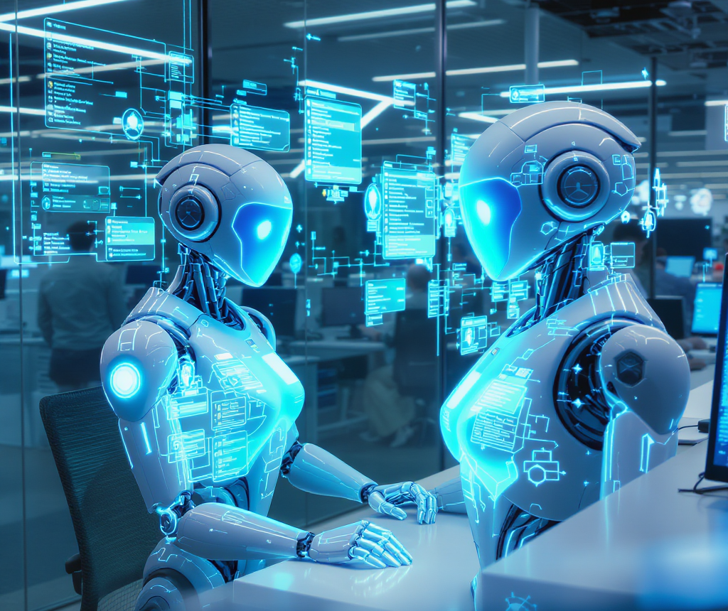

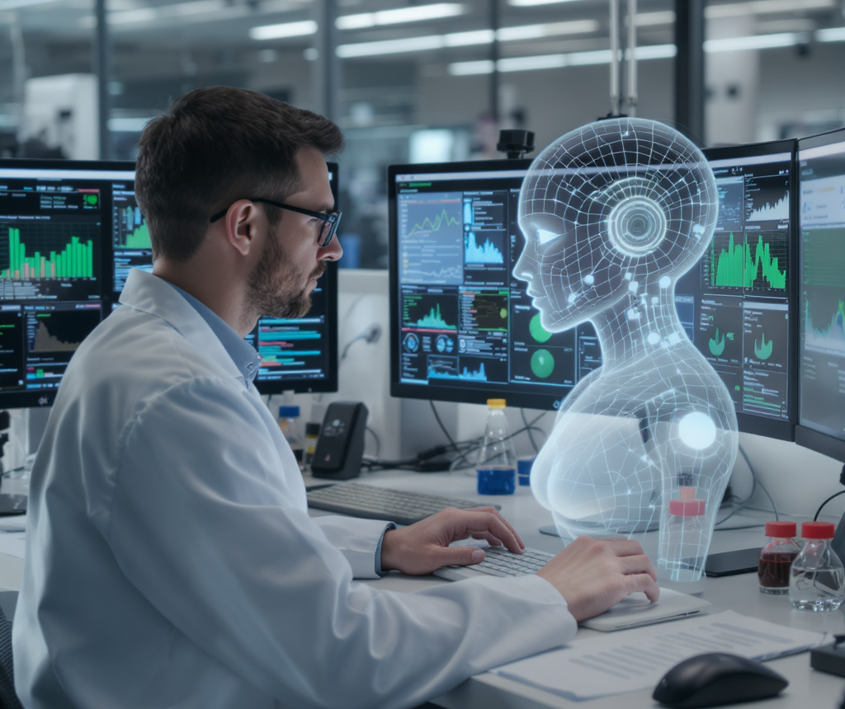

Real-World Applications Transforming Industries
Applications
Customer Service
Software Development
Research & Analysis
Business Operations
Autonomous agents resolve support tickets, escalate complex issues, and personalize responses for seamless customer experiences.
AI agents autonomously write, test, debug, and deploy code, accelerating development cycles with minimal human intervention.
Agents gather data autonomously, synthesize insights, and generate comprehensive reports for informed decision-making.
Agents manage workflows, schedule tasks, and coordinate across enterprise systems to optimize operational efficiency.

Slide 7
How Agentic AI Works: The Perception–Reasoning–Action Loop
Mechanism
Perceive
Reason & Plan
Act & Reflect
The agent gathers inputs like user commands, data feeds, tool outputs, and memory to build situational awareness.
The agent uses an LLM-powered engine to break down goals, evaluate options, and sequence actions into a plan.
The agent executes actions (API calls, code, searches), monitors results, learns from feedback, and updates its strategy.
Input aggregation
Contextual data capture
Memory retrieval
Environment scanning
Goal decomposition
Option evaluation
Multi-step action sequencing
Plan formulation
Action execution
Outcome monitoring
Feedback integration
Iterative learning and adaptation

Slide 8
Opportunities Are Immense — But So Are the Risks
Risks & Rewards
Opportunities
Risks & Challenges
Increased productivity in routine and complex task
24/7 autonomous operations without fatigue.
Faster research and development cycles.
Greater scalability in service and operations.
Misaligned goals causing harmful actions
Reduced human oversight and accountability.
Security risks from tool and data access.
Potential job displacement and reskilling needs.

Slide 9
The Road Ahead: Key Trends Shaping Agentic AI
Future Trends
Multi-Agent Collaboration
Human-Agent Teaming
Standardized Agent Protocols
Governance & Safety Frameworks
Specialized AI agents form interconnected networks to tackle complex challenges by sharing knowledge, dividing tasks, and optimizing outcomes collaboratively.
Hybrid workflows integrate human judgment with agent autonomy, enabling real-time co-piloting of decisions for enhanced efficiency and reliability.
Frameworks like MCP establish common communication and operation standards, allowing diverse agents and systems to interoperate securely and seamlessly.
Industry and regulatory bodies are developing guidelines, audit mechanisms, and accountability standards to ensure ethical and secure use of autonomous AI.

Slide 10
Conclusion
Agentic AI marks a revolutionary shift from tools we command to autonomous partners that act independently.
This new era transforms human-machine collaboration by enabling AI systems to pursue complex goals with minimal oversight. Organizations that embrace and govern agentic AI responsibly today will shape the future competitive landscape and unlock unprecedented innovation and efficiency.

Slide 11
Conclusion
01
Agentic AI Is Distinct
Autonomous, adaptive, goal-driven, tool-using, and collaborative — five traits that separate it from traditional AI
Key Takeaways
02
A Paradigm Shift Is Underway
We're moving from static, prompt-response systems to agents that reason, plan, and act on their own
03
Industries Are Already Transforming
Healthcare, finance, manufacturing, and more are deploying autonomous agents at scale today
04
The Architecture Enables Autonomy
The perception–reasoning–action loop is the engine, and the market is responding with rapid investment
05
Governance Is Non-Negotiable
The opportunity is massive, but responsible adoption and oversight will determine who leads and who falls behind

Slide 12
References
Citations & Further Reading
1. Lou, B., Zhang, Y., et al. (2025). "Unraveling Human-AI Teaming: A Review and Outlook." arXiv preprint arXiv:2504.05755.
2. Naik, S., Toombs, A., Snellinger, A., Saponas, S., & Hall, A. K. (2025). "Exploring Human-AI Collaboration Using Mental Models of Early Adopters of Multi-Agent Generative AI Tools." arXiv preprint arXiv:2510.06224.
3. Pandey, R. (2025). "The Agentic AI Governance Framework: A Universal Model for Risk, Accountability, and Compliance in Autonomous Systems." SSRN, doi:10.2139/ssrn.5652350.
4. OWASP Foundation. (2025). "State of Agentic AI Security and Governance 1.0." OWASP GenAI Security Project.
5. KPMG LLP. (2025). "AI Governance for the Agentic AI Era." KPMG Trusted AI Framework Report, July 2025.

